Slide 1
Multivariate Regression Analysis of Air Quality Index
ISYE-6414
Ishika Arora Ian Jiang Tess Leggio
Notes:
PRESENTER: TESS

Slide 2
Research Question
How is air quality in the United States related to demographic, emissions, and weather factors?
Temperature
Population
Per capita income
Greenhouse gas emissions
Industrial power consumption and generation
Notes:
PRESENTER: TESS

Slide 3
What is the Air Quality Index?
The Air Quality Index (AQI) is a measure of the local air quality calculated by the EPA.
Based upon the concentration of six major ground-level pollutants: ground-level ozone, particle pollution (classified by two different particle sizes), carbon monoxide, nitrogen dioxide, and sulfur dioxide.
The largest (dominant) value of the six is reported.
Most importantly, AQI is a measure of how hazardous the local environment can be for human health.
Notes:
PRESENTER: TESS
AQI = measure of local air quality
Important for human health
Function of 6 ground-level pollutant AQIs

Slide 4
Data Collection & Cleaning
Population Data
census.gov
Formatting of key variables (Date, State, County)
Ensure uniqueness of key variables
Merging of data
Exclude columns with too many missing values
Remove spurious observations
Checking extreme values for all variables
AQI Data
aqs.epa.gov
Greenhouse Gas Emissions
epa.gov
Final Merged Dataset
Per Capita Income
bea.gov
Powerplant Power Data
eia.gov
Temperature Data
mesowest.utah.edu
Notes:
PRESENTER: TESS
Data collected from different 6 sources listed
Given from 6 different, had to make sure it was in a format that could be merged together (ex: make sure county names match, etc.)
Had to investigate and remove bad data (ex: Iberville)
Get final merged data set for modeling
Several hundred thousand (vs. millions from initial data sets before pruning)

Slide 5
Modeling AQI
The overall AQI for a county is a function of the 6 individual pollutant AQIs
Upon noting the differences in residual spreads by defining parameter, decided to fit models for each individual pollutant AQI
Notes:
PRESENTER: TESS
In our original data, looking at the defining parameters, saw significant differences in distributions, leading us to believe that splitting into 6 different models best

Slide 6
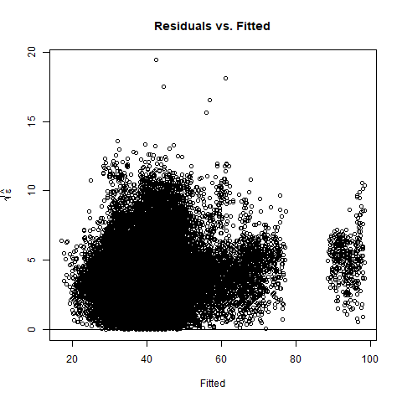
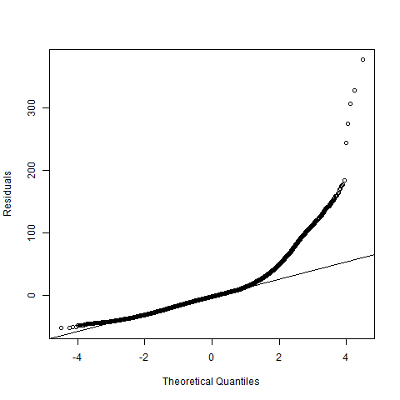
Model Diagnostics Example – Initial overall AQI model
Constant Variance Assumption
Plot of residuals vs. fitted values indicated heteroscedasticity
Transformations required to address homoscedasticity
Normality Assumption
QQ-plot of residuals indicated that errors were right-skewed
Address non-normality through transformations
Notes:
PRESENTER: ISHIKA
From the residuals vs. fitted values of initial model, saw that residuals did not have constant variance
From QQ plot, saw that residuals were not normal
Based on these diagnostics, see that we need to transform the model

Slide 7
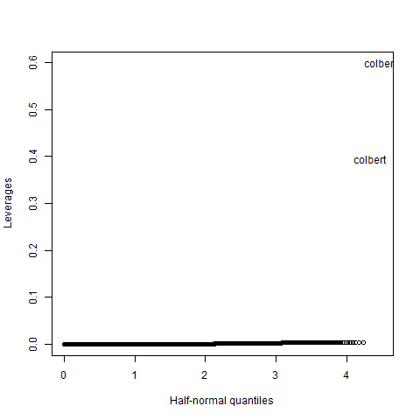


Model Diagnostics Example – Initial overall AQI model
Investigate Outliers
Examine studentized residuals, $t_{i}$, paying close attention to those values exceeding the Bonferroni critical value
Plot to visualize if there exist multiple outliers that may hide one another
Investigate High Leverage Points
Identify points with high leverage values $\left(h≫\frac{2p}{n}\right)$
Removing two high leverage observations from Colbert, AL has little effect on model fit due to large dataset
Upon investigation, determined likely
to be data entry errors
Notes:
PRESENTER: ISHIKA
Looked at studentized values and hat values to remove outliers and large leverages
LARGE dataset, so removing these did not affect model much

Slide 8
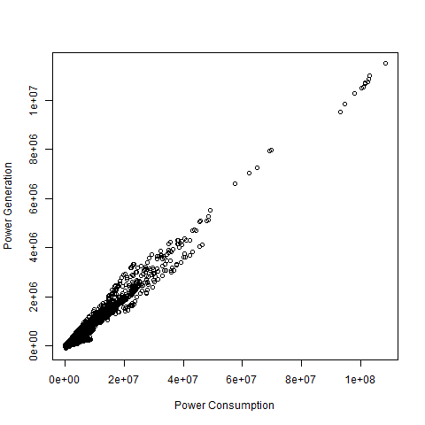
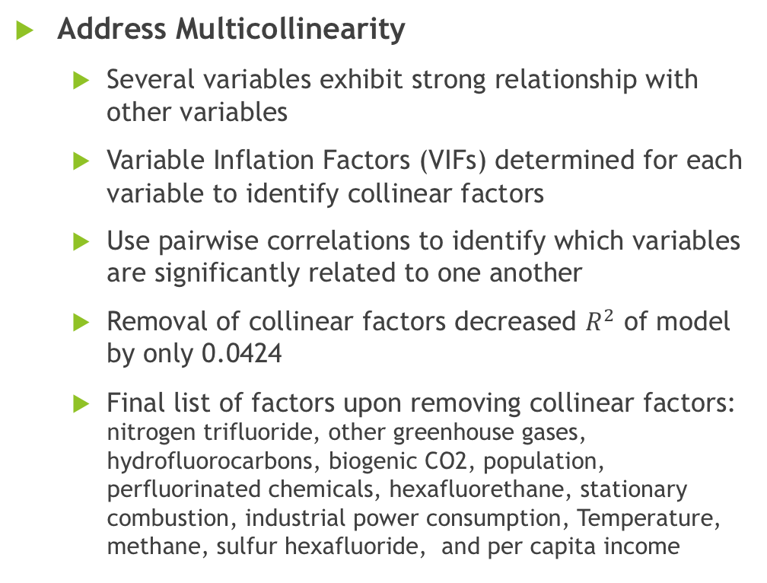
Model Diagnostics Example – Initial overall AQI model
Address Multicollinearity
Several variables exhibit strong relationship with other variables
Variable Inflation Factors (VIFs) determined for each variable to identify collinear factors
Use pairwise correlations to identify which variables are significantly related to one another
Removal of collinear factors decreased $R^{2}$ of model by only 0.0424
Final list of factors upon removing collinear factors: nitrogen trifluoride, other greenhouse gases, hydrofluorocarbons, biogenic CO2, population, perfluorinated chemicals, hexafluorethane, stationary combustion, industrial power consumption, Temperature, methane, sulfur hexafluoride, and per capita income
Notes:
PRESENTER: ISHIKA
Having built initial model and just by looking at the individual factors, saw that several factors were collinear (ex: CO2 emissions and output for stationary combustion)
Using VIF
Using plots to see relationship between variables
Using pairwise correlations
Removed predictors highly correlated with others and refit model
Having removed these predictors, can see that R2 doesn’t change much, leaves significant predictor
Removal of collinear factors decreased $R^{2}$ of model from 0.1024 to 0.096, a relatively modest change
_____ are the factors we used

Slide 9
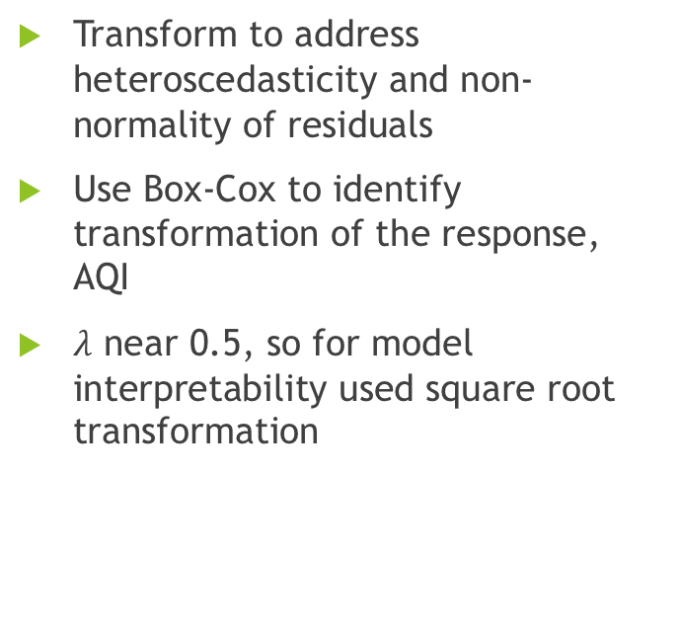
Model Transformation Example – Initial overall AQI model
Transform to address heteroscedasticity and non-normality of residuals
Use Box-Cox to identify transformation of the response, AQI
$λ$ near 0.5, so for model interpretability used square root transformation
Repeat diagnostics as necessary as we refit and improved models
Notes:
PRESENTER: IAN
In order to address non-normality and heteroscedasticity (non-constant variance)
Lambda close to 0.5, so we took square root to help with model interpretability
Repeat processes

Slide 10
Results & Conclusions
All models significant at 5% level
Relatively low R² values indicate that while these factors are significantly related to AQI, there are other factors not included in model which capture more variation in the response
Temperature, Biogenic CO2, perfluorinated chemicals, and population, among others, are highly significant predictors for all AQI models
Component of AQI | R²
NO₂ | 0.2126
CO | 0.1513
PM10 | 0.1816
Ozone | 0.1192
SO₂ | 0.062
PM2.5 | 0.059
Notes:
PRESENTER: IAN
___ these factors____ are significantly related to air quality
_____ was most significant factor, agreeing with literature
Each model was statistically significant at 5% level, though had relatively low R2, indicating that there may be other factors out there not presently considered that may explain more variation in the response

Slide 11
Future Research Directions
Investigate non-linear models
Initial investigation of nonlinear additive model
Include additional weather variables
Wind speed, humidity, and precipitation, etc.
Investigate at city level rather than county level
Investigate air quality across the globe
Consider over larger time interval
Notes:
PRESENTER: IAN
Took an initial look at nonlinear additive models, which seem promising in terms of % deviance explained
We could create a more comprehensive model by looking at include addition weather factors, etc.
Include wider range of data in terms of time and geography

